Slide 1
3D Point Cloud Classification
Students: HUANG Jianhua
Notes:
Good evening, everyone, my project topic is 3D Point Cloud Classification.

Slide 2
01
Project Introduction
Content
02
PointNet Classification Network
03
From PointNet to PointNet++
04
Result
Notes:
The presentation is divided into these four parts: Introduction, PointNet, PointNet++ and the result.

Slide 3
01
Project Introduction

Slide 4
1. Project Introduction
Classification models: PointNet and PointNet++
Deep learning environment: Google Colab
Code reference: Github (https://github.com/yanx27/Pointnet_Pointnet2_pytorch)
Dataset: ModelNet40/10
Purpose: Learn the point cloud classification models and compare their differences.
Notes:
Yes, let’s turn to the introduction.
In this project, I use two Classification models: PointNet and PointNet++. I download the code from github, which implements these two models with pytorch. And I train and test it on Google Colab.
The dataset used is ModelNet, which is a very basic point cloud classification dataset. And the purpose of this project is to learn the point cloud classification models and compare their differences.

Slide 5
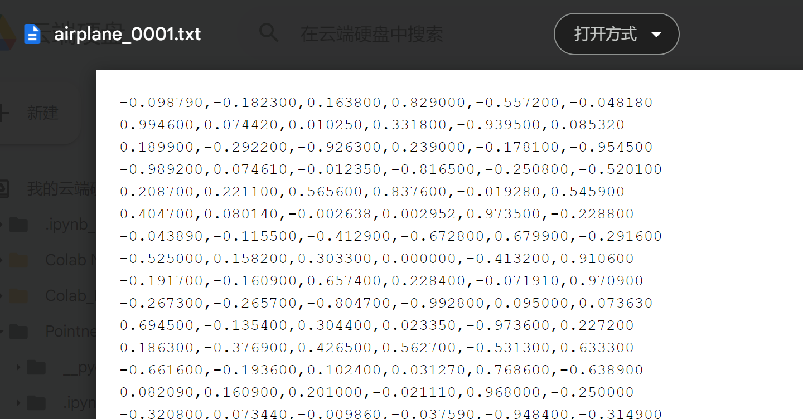
1. Project Introduction
There are about three steps, Data Preprocessing, Train and Test.
Data Preprocessing：The CAD models of the ModelNet data are in Object File Format (OFF), Then we convert it into text data. Each text represents a point cloud model, and each line of data represents a point. There are 6 numbers in each line (x, y, z, r, g, b).
Notes:
There are about three steps, Data Preprocessing, Train and Test.
The CAD models of the dataset are in Object File Format (OFF), so we convert it into text data. And the text files are like that, each text represents a point cloud model, and each line represents a point. There are 6 numbers in each line (x, y, z, r, g, b), which represent the coordinates and color.

Slide 6
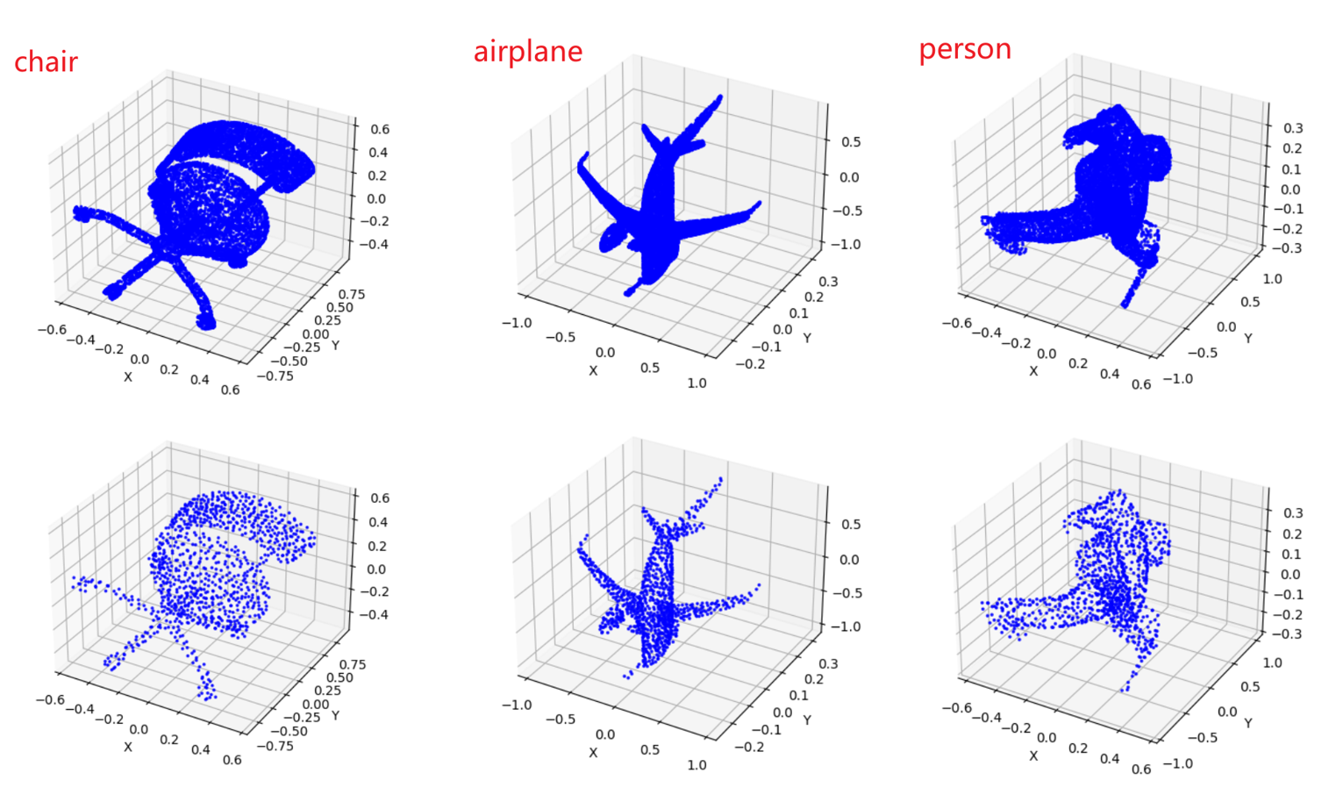
1. Introduction
Each point cloud model has 10,000 points, and the first 1024 points are used as sampling points.
Visual comparisons before and after sampling：
Notes:
Each point cloud model has 10,000 points, and we sampled the first 1024 points.
The picture shows comparisons before and after sampling

Slide 7
02
PointNet Classification Network
Notes:
All right, let’s look at the second part PointNet Classification Network.

Slide 8
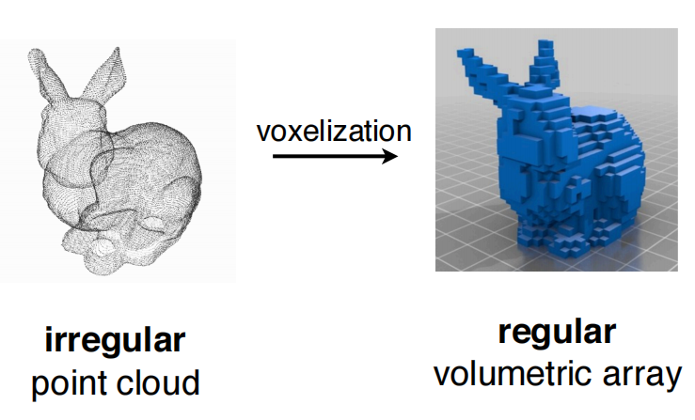
2. PointNet Classification Network
In the previous work, point cloud is converted to other
representations before it is input to a deep neural network.
PointNet's goal:
Achieve effective feature learning directly on point clouds.
Two properties of point clouds:
Permutation Invariance: Point cloud is a set of unordered points.
--- Symmetric functions, max pooling
2. Transformation Invariance: Point cloud rotations cannot alter classification results.
--- T-net
Notes:
In the previous work, point cloud is converted to other representations before it is input to a deep neural network. Such as regular 3D voxel grids or collections of images. And pointnet wants to achieve feature learning directly on point clouds.
There are two properties of point clouds that the pointnet should consider:
Permutation Invariance and Transformation Invariance.

Slide 9
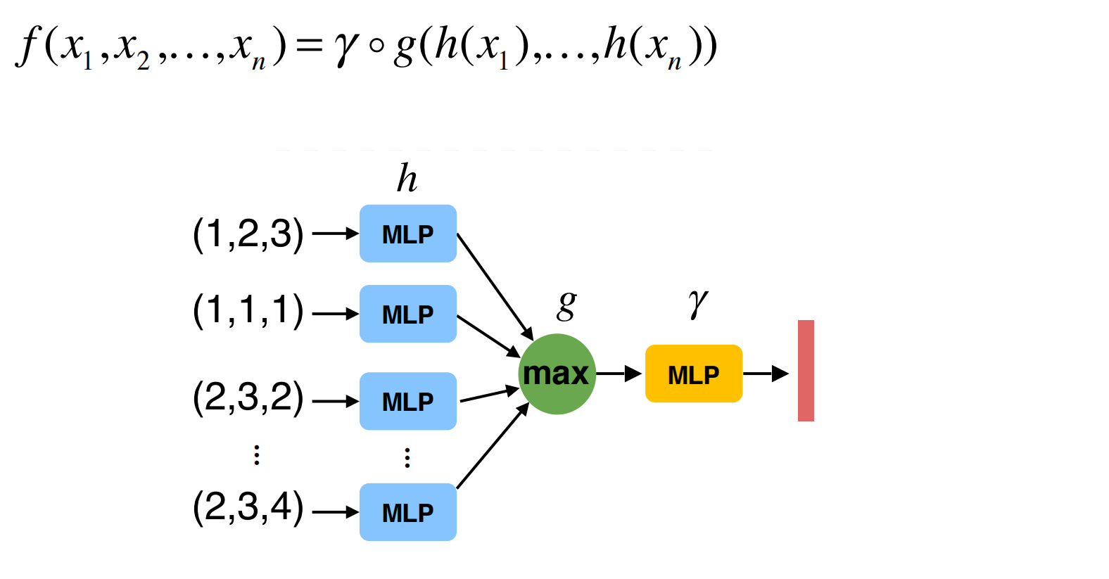
2. PointNet Classification Network
PointNet’s basic idea:
Direct max pooling operation will lose meaningful geometric information.
We can map each point to a higher-dimensional space before max pooling.
Aggregation in the (redundant) high-dim space preserves more information of the geometry.
Notes:
This picture shows the basic idea of PointNet
There are about three steps in PointNet, first, do dimensionality increase operation of each point, max pooling and Dimensionality reduction.

Slide 10
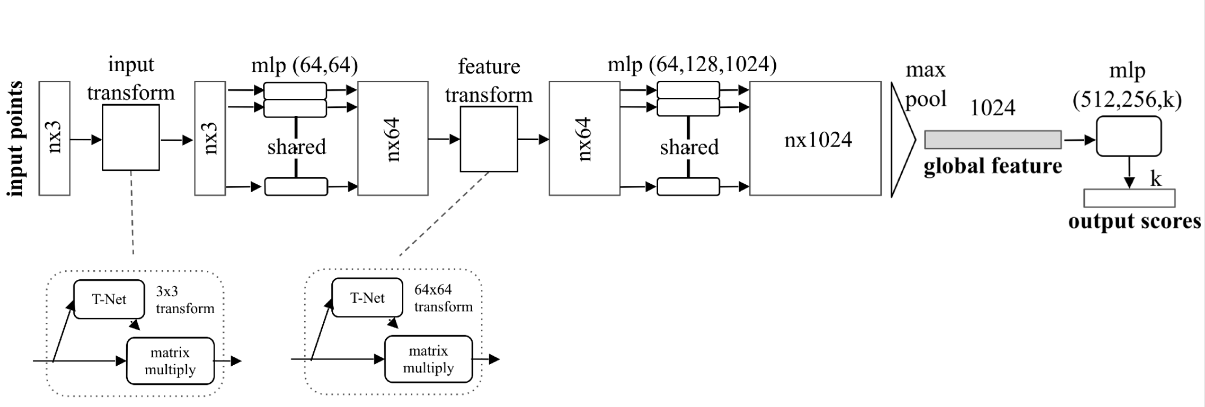
2. PointNet Classification Network
Use Multi-layer Perceptron(MLP) to
increase the dimension of the feature vector.
Aggregates point features by max pooling
Dimensionality reduction to K
Notes:
Let’s look at the PointNet Classification Network,
In the first section, it uses Multi-layer Perceptron (MLP) to increase the dimension of the feature vector. From the initial three-dimensional, after two dimension-up operations, finally to 1024-dimensional.
And then aggregates point features by max pooling.
Finally, Dimensionality reduction to K because of K classes.
There are two T-net modules.
In fact, T-net is not very useful for this dataset, and PointNet++ does not use it.

Slide 11
03
From PointNet to PointNet++

Slide 12
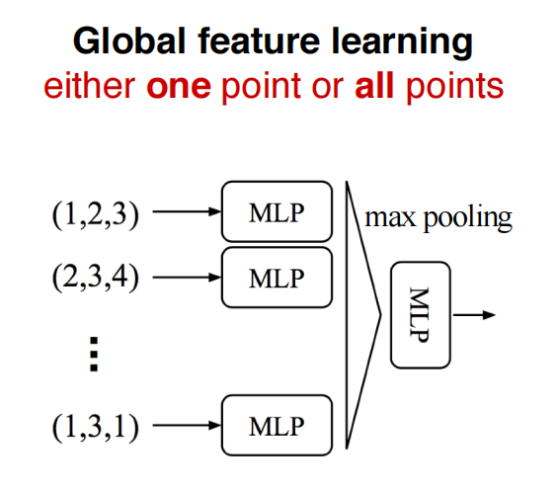
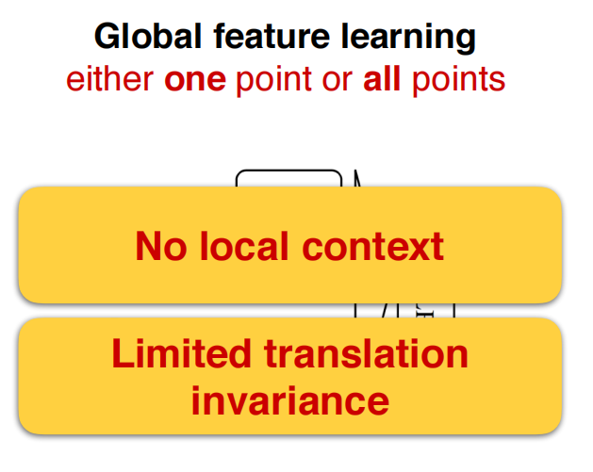
3. From PointNet to PointNet++
Limitations of PointNet
Pointnet++ is mainly aimed at improving this.
Notes:
After the analysis of PointNet, we can find two limitations of it.
At the beginning, each point is made a high-dimensional mapping, and then all points are combined by max pooling. This essentially either operates on one point, or operates on all points. So, there is no local context.
There are also limitations in translation invariance. For example, The input is the coordinates of xyz. Suppose a translation is made for the point cloud, then all xyz will be different, which will cause all the features to be different, and the final global features will be different.

Slide 13
3. From PointNet to PointNet++
Basic idea of PointNet++: Recursively apply PointNet at local regions.
Hierarchical feature learning
Translation invariant
Permutation invariant
Notes:
Basic idea of PointNet++: Recursively apply PointNet at local regions.

Slide 14
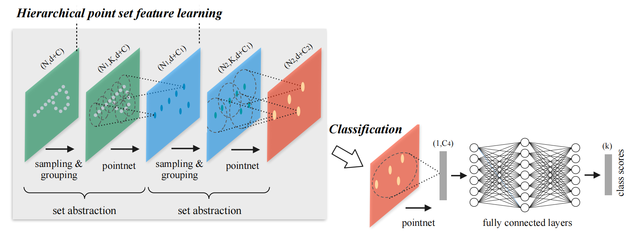
3. From PointNet to PointNet++
Set Abstraction: farthest point sampling + grouping + pointnet
Sampling & Grouping, that is, how to determine the center point of each local area and the size of each area.
Notes:
Sampling & Grouping, that is, how to determine the center point and the size of each local area.
It uses the farthest point sampling, the advantage of this sampling is that the down-sampling results will be more uniform.
Farthest point sampling is a greedy algorithm that samples from a point cloud data iteratively. It starts from a random single sample of point. In each iteration, it samples from the rest points that is the farthest from the set of sampled points.
最远点采样是一种从点云数据中迭代采样的贪心算法。 它从随机的单个点样本开始。 在每次迭代中，它从距离采样点集最远的其余点采样。

Slide 15
04
Result

Slide 16
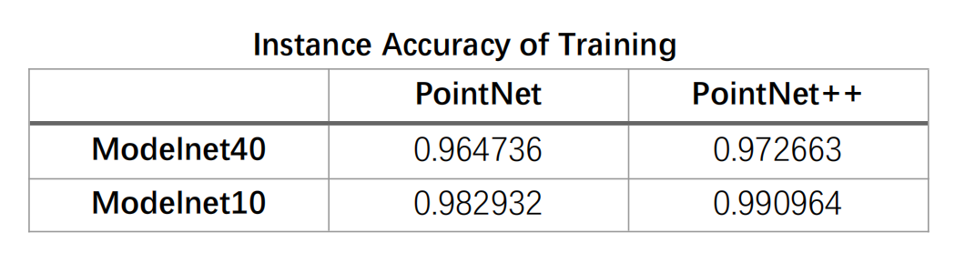
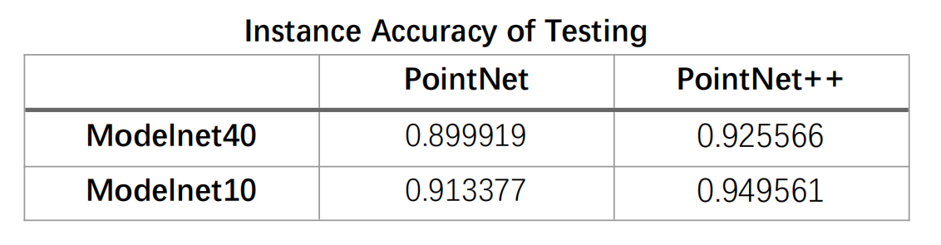
4. Result
The classification result of PointNet++ is a little better than that of PointNet, because PointNet++ has made improvements on PointNet.
Notes:
This is the result of training and test,
We can see the classification result of PointNet++ is a little better than that of PointNet, because PointNet++ has made improvements on PointNet.
为什么model10的比model40 结果好？
我觉得是因为这model10可能会比 model40的缺少一些比较相似的类别，像床和桌子，可能我应该要把每个类的准确率算出来。
I think it is because model10 may lack some similar categories than model40, such as beds and tables. Maybe I should calculate the accuracy of each category.
不懂
Sorry, l didn't catch all of that question.
I'm sorry I'm afrald I don't know the question. I will look into that later.

Slide 17
Thanks for your attention!
Notes:
为什么model10的比model40 结果好？
我觉得是因为这model10可能会比 model40的缺少一些比较相似的类别，像床和桌子，可能我应该要把每个类的准确率算出来。
I think it is because model10 may lack some similar categories than model40, such as beds and tables. Maybe I should calculate the accuracy of each category.
不懂
Sorry, l didn't catch all of that question.
I'm sorry I'm afrald I don't know the question. I will look into that later.

